Slide 1

Object Oriented Programming
Object-Oriented Programming
2305CS102
Prof. Swati R Sharma
Computer Engineering Department
swati.sharma@darshan.ac.in

Slide 2
Teaching and Examination Scheme
Teaching Scheme (Contact Hours) |  |  |  | Examination Scheme
Lecture | Tutorial | Lab | Credit | Theory Marks |  | Practical Marks |  | Total Marks
 |  |  |  | SEE | CIA | SEE | CIA
4 | 0 | 2 | 5 | 40 | 30 | 20 | 10 | 100
SEE - Semester End Examination, CIA - Continuous Internal Assessment (It consists of Assignments/Seminars/Presentations/MCQ Tests, etc.)

Slide 3
Syllabus

Slide 4
Syllabus
Sr. | Content | T Hrs | W %
1 | Introduction to JAVA | 10 | 21
2 | Object Oriented Concepts | 15 | 23
3 | Inheritance and Abstraction | 12 | 15
4 | Package, Exception Handling and Multithreading | 13 | 23
5 | IO Programming and Collection Framework | 10 | 18

Slide 5
Unit-1 Introduction to java
Object-Oriented Programming Using Java
2305CS102
Prof. Swati R Sharma
Computer Engineering Department
swati.sharma@darshan.ac.in

Slide 6
Unit-1

Looping
What we will learn
Evolution of Java
Features of JAVA,
JDK, JRE, JVM, Byte Code
Installing and configuring JAVA
Basic Structure of Java program
Compiling and Running Java files

Slide 7

Introduction
Welcome to the world of Programming

Slide 8

What is Language?
A language is a system of communication used by a particular country or community.
It is a structured system of communication used by humans, based on speech and gesture (spoken language), sign or often writing.
Both person should understand each other’s language.
Hello!
કેમ છો!
你好
મજામાં

Slide 9

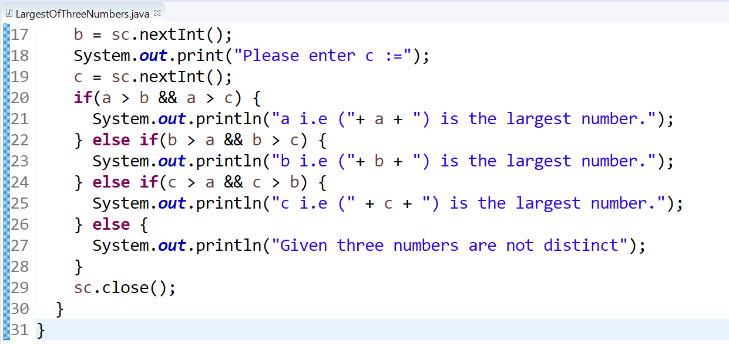
Programming Language
A programming language is a computer language that is used by programmers (developers) to communicate with computers.
It is a set of instructions written in a specific language to perform a specific task.
It allow us to give instructions to a computer in a language the computer understands.
5000+ programming languages are there, notably used are approximate 250.
E.g. C, C++, C#, Java, Python, PHP, Pascal, etc.

Slide 10
Types of Programming Languages
Low-level programming language
It is a machine-dependent (hardware specific) programming language.
It consists of a set of instructions that are either in the binary form (0 or 1) or in a symbolic and human-understandable mnemonics (ADD, MOV, SUB).
E.g. Machine level language, Assembly language, etc.
High-level programming language
It is closer to human languages than machine-level languages.
It is easy to read, write, and maintain as it is written in English like words.
It allows to write the programs which are independent of a particular type of machine (hardware).
A compiler is required to translate a high-level language into a low-level language.
E.g. Python, Java, JavaScript, PHP, C#, LISP, FORTRAN, etc.
Middle-level programming language
Middle-level programming language lies between the low-level and high-level programming language.
E.g. C, C++, etc.

Slide 11



Slide 12













Applications implemented in Java

Slide 13

Introduction to

Slide 14

JAVA Installation
Java is a general-purpose computer-programming language that is open source, platform independent, object-oriented and specifically designed to have as few implementation dependencies as possible.
Java was originally developed by James Gosling at Sun Microsystems and released in 1995.
Java was initially named as Oak language and renamed to JAVA in 1995.
Current Version | Java SE 22 (as of September, 14th 2021)
Version we will use | Java SE 21 (LTS)
Setup size | 149 MB (Linux), 152 MB (Windows x64)
Download Link | https://www.oracle.com/in/java/technologies/javase-jdk11-downloads.html
Official Website | https://java.com
Integrated Development Environment (IDE) | Eclipse NetBeans IntelliJ IDEA Community Edition BlueJ

Slide 15
JAVA Installation: help
Download JDK for Windows platform (.exe) from
https://www.oracle.com/technetwork/java/javase/downloads/index.html
Install the executable of JDK
Set the path variable of System variables by performing following steps
Go to "System Properties" (Right click This PC → Properties → Advanced System Settings)
Click on the "Environment variables" button under the "Advanced" tab
Then, select the "Path" variable in System variables and click on the "Edit" button
Click on the "New" button and add the path where Java is installed, followed by \bin. By default, Java is installed in C:\Program Files\Java\jdk-11.0.1 (If nothing else was specified when you installed it). In that case, You will have to add a new path with: C:\Program Files\Java\jdk-11.0.1\bin
Then, click "OK", and save the settings
At last, open Command Prompt (cmd.exe) and type java -version to see if Java is running on your machine

Slide 16
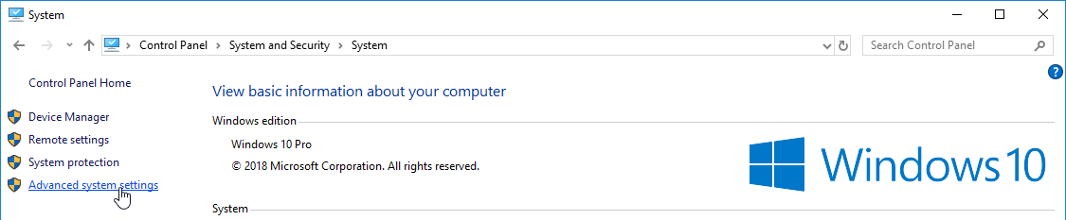
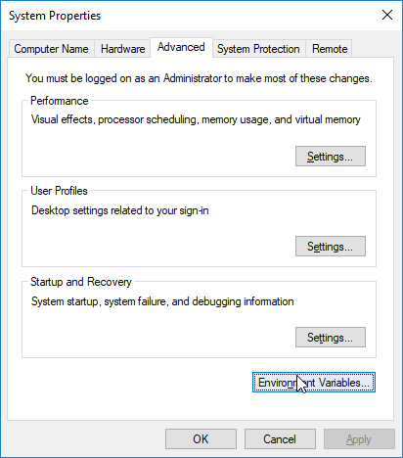
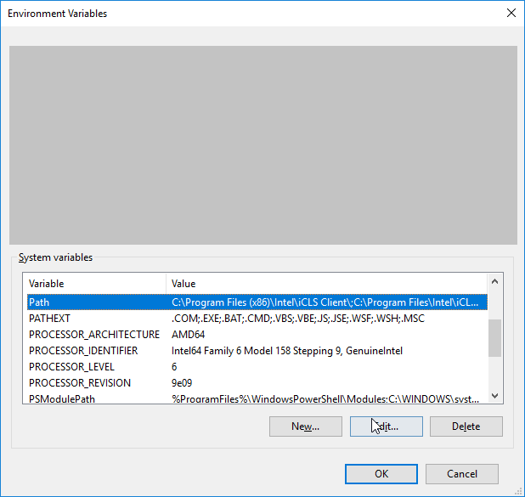
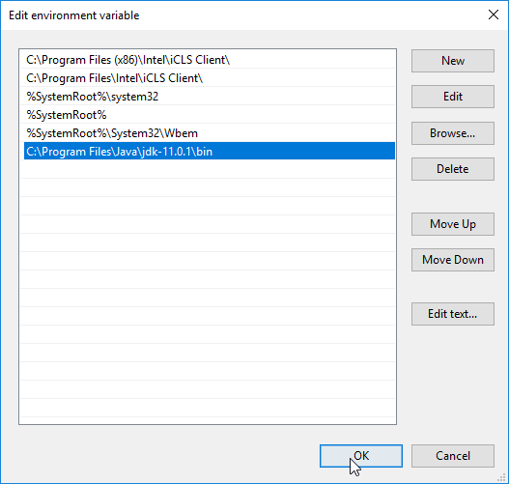
JAVA Installation : Setting Path Variable
1
2
3
4

Slide 17
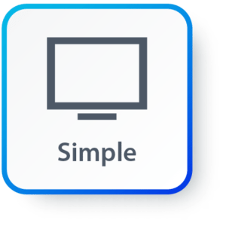
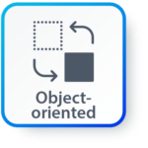
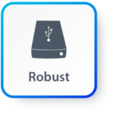

Features of JAVA
Simple: Java inherits C/C++ syntax and many object-oriented features of C++.
Object Oriented: “Everything is an object” paradigm, which possess some state, behavior and all the operations are performed using these objects.
Robust: Java has a strong memory management system. It helps in eliminating error as it checks the code during compile and runtime.
Multithreaded: Java supports multiple threads of execution, including a set of synchronization primitives. This makes programming with threads much easier.

Slide 18



Features of JAVA (Cont.)
Architectural Neutral: Java is platform independent which means that any application written on one platform can be easily ported to another platform.
Interpreted: Java is compiled to bytecodes, which are interpreted by a Java run-time environment.
High Performance: Java achieves high performance through the use of bytecode which can be easily translated into native machine code. With the use of JIT (Just-In-Time) compilers, Java enables high performance.

Slide 19

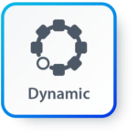
Features of JAVA (Cont.)
Distributed: Java provides a feature which helps to create distributed applications. Using Remote Method Invocation (RMI), a program can invoke a method of another program across a network and get the output. You can access files by calling the methods from any machine on the internet.
Dynamic: Java has ability to adapt to an evolving environment which supports dynamic memory allocation due to which memory wastage is reduced and performance of the application is increased.

Slide 20
Components of Java
Java Virtual Machine (JVM)
Java Runtime Environment (JRE)
Java Development Kit (JDK)
JDK
Compiler (javac.exe)
Java Application
Launcher (java.exe), AppletViewer, etc..)
Java Packages
(math, util, awt etc…)
JVM
Runtime Libraries
Development tools
JRE

Slide 21
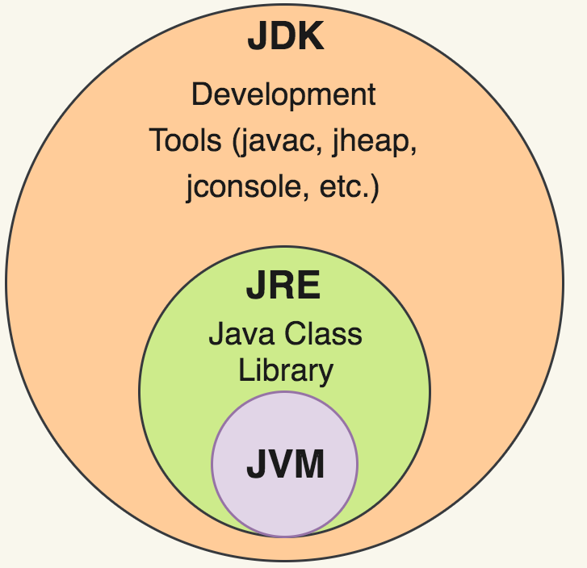
Java Development Kit (JDK)
JDK contains tools needed ,
To develop the Java programs and
JRE to run the programs.
The tools include
compiler (javac.exe),
Java application launcher (java.exe),
Appletviewer, etc…
Java application launcher (java.exe) opens a JRE, loads the class, and invokes its main method.

Slide 22
Java Runtime Environment (JRE)
The JRE is required to run java applications.
It combines the Java Virtual Machine (JVM), platform core classes and supporting libraries.
JRE is part of the Java Development Kit (JDK), but can be downloaded separately.
It does not contain any development tools such as compiler, debugger, etc.

Slide 23
Java Virtual Machine (JVM)
JVM is a virtual machine that enables a computer to run Java programs as well as programs written in other languages and compiled to Java Bytecode.
Bytecode is a highly optimized set of instructions designed to be executed by the Java Virtual Machine(JVM).
Byte code is intermediate representation of java source code.
Java compiler provides byte code by compiling Java Source Code.
Extension for java class file or byte code is ‘.class’, which is platform independent.
JVM is virtual because , It provides a machine interface that does not depend on the operating system and machine hardware architecture.
JVM interprets the byte code into the machine code.
JVM itself is platform dependent, but Java is Not.

Slide 24
How Java become Platform Independent?
Source code (Program)
.java file
Compiler
Bytecode
.class file
JVM
(Windows)
JVM
(Linux)
JVM
(Mac)
Machine Code
Machine Code
Machine Code

Slide 25
Bytecode: Java’s Magic
Bytecode is a highly optimized set of instructions designed to be executed by the JVM
Here, JVM is an interpreter for bytecode.
Translating a Java program into bytecode helps makes it much easier to run a program in a wide variety of environments.
i.e “WRITE ONCE RUN ANYWHERE”
Thus, the interpretation of bytecode is the easiest way to create truly portable programs.
Interpreted Java program are highly secured, because the execution of every Java program is under the control of the JVM.
Source code (Program)
.java file
Compiler
Bytecode
.class file

Slide 26
Java Interview Question
Difference between JRE and JVM?
Difference between interpreter and JIT compiler?
Justify Java is platform independent.
Justify Java gives high performance.
Justify Java is Robust language.
What are Java bytecodes?
JVM vs. JRE vs. JDK

Slide 27
First Java Program

Slide 28
Hello World Java Program
File must be saved as HelloWorld.java
public class HelloWorld
{
public static void main(String[] args)
{
System.out.println("Hello World");
}
}
We have to save this in HelloWorld.java file as it has public class named HelloWorld.
String and System are inbuilt Java Classes.
Classes in java are always written in Camel case.
Main method from where execution will start
String must start with capital letter
System must start with capital letter

Slide 29
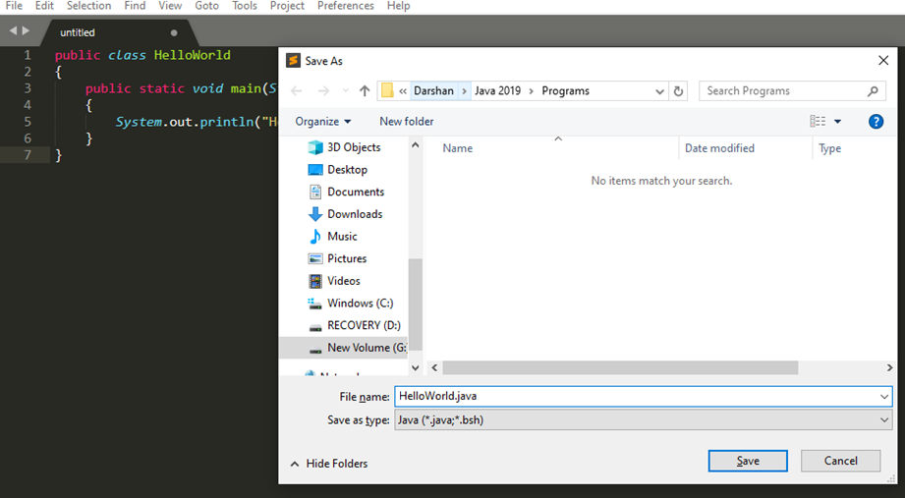
How to execute Java Program?
Save the program with the same name as the public class with .java extension.

Slide 30
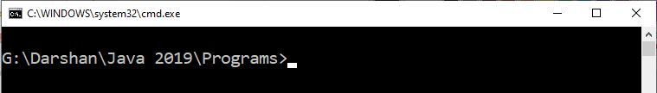
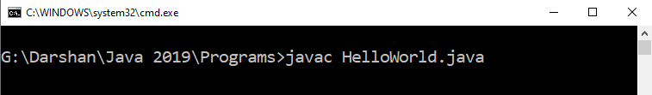
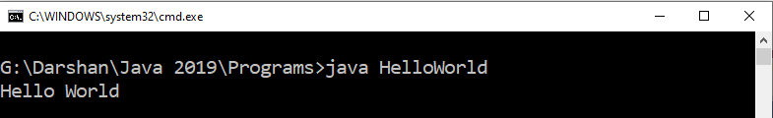
How to execute Java Program?
Open command prompt (cmd) / terminal & navigate to desired directory / folder.
Compile the “.java” file with javac command.
Execute the “.class” file with java command without extension.

Slide 31
Assignment-1
Differentiate JRE,JDK and JVM.
Why Java is platform independent?

Slide 32
Unit-1(part-II) Data types, Variables & Operators
Object-Oriented Programming
2305CS102
Prof. Swati R Sharma
Computer Engineering Department
swati.sharma@darshan.ac.in

Slide 33
Unit-1(part-II)

Looping
What we will learn
Primitive data types
String
Variables
Type casting
Command line arguments
Operators
Operator precedence

Slide 34
Tokens

Slide 35
Tokens
The smallest individual unit of a language / program is known as a token.
Tokens are basic building blocks of any language.
“Jane bakes tasty cookies.”
Jane is noun
bakes is verb
tasty is adjective
cookies is noun
‘.’ is special character to end the sentence.
Each and every word and punctuation is a token.
We divide sentence into tokens to understand the meaning of a sentence.
Similarly, the compilers of programming language breaks a program into the tokens and proceeds to the various stages of the compilation.
However, collection of tokens in appropriate sequence makes a meaningful sentence.

Slide 36
Classification of Tokens
Sr. | Token | Description | Examples
1 | Keywords | Predefined reserved words | void, int, float, for, if
2 | Identifiers | User-defined combination of alphanumeric characters. Name of a variable, function, class, etc. | a, i, sum, number, pi
3 | Constants | Fixed values that do not change | 17, -25.50, 82, 0
4 | Strings | A sequence of characters | “Darshan”, “Hi!”
5 | Special Symbols | Symbols that have special meaning | #, $, @, %, =, :, ;
6 | Operators | A symbol that performs operation on a value or a variable | +, -, *, /

Slide 37
Identifiers

Slide 38
Identifiers
They are used for class names, method names and variable names.
An identifier may be any descriptive sequence of
uppercase(A…Z) and lowercase(a..z) letters
Numbers(0..9)
Underscore(_) and dollar-sign($) characters
Examples for valid Identifiers,
AvgTemp
count
a4
$test
this_is_ok
Examples for invalid Identifiers,
2count
High-temp
Ok/NotOK
(Identifiers can not start with digit)
(Identifiers can not contain dash)
(Identifiers can not contains slash)

Slide 39
Identifier Name Valid or Invalid?
for | Rajkot | _Name | If | Roll Number | Rs.
_________a | int | student | _7 | Identifier | Valid
C | C++ | Java | C# | Compiler | ___8__a__8
7Student | Who? | v.a.l.u. | A_B_C_D_E | i | if
Int | A2020 | 2021 | sum | a,b,c | i;

Slide 40
Data Types
Java Datatypes
Primitive
Non-primitive
Integers
Floating-point numbers
Characters
Boolean
Class

Slide 41
Primitive Data Types
Data Type | Size | Range | Example
byte | 1 Byte | -128 to 127 | byte a = 10;
short | 2 Bytes | -32,768 to 32,767 | short a = 200;
int | 4 Bytes | -2,147,483,648 to 2,147,483,647 | int a = 50000;
long | 8 Bytes | -9,223,372,036,854,775,808 to 9,223,372,036,854,775,807 | long a = 20;
float | 4 Bytes | 1.4e-045 to 3.4e+038 | float a = 10.2f;
double | 8 Bytes | 4.9e-324 to 1.8e+308 | double a = 10.2;
char | 2 Bytes | 0 to 65536 (Stores ASCII of character) | char a = ‘a’;
boolean | Not defined | true or false | boolean a = true;

Slide 42
Escape Sequences
Escape sequences in general are used to signal an alternative interpretation of a series of characters.
For example, if you want to put quotes within quotes you must use the escape sequence, \", on the interior quotes.
System.out.println("Good Morning \"World\"");
Escape Sequence | Description
\’ | Single quote
\” | Double quote
\\ | Backslash
\r | Carriage return
\n | New Line
\t | Tab

Slide 43
Variables in Java

Slide 44
Variables in Java
The variable is the basic unit of storage in a Java program.
A variable is defined by the combination of an identifier, a type, and an optional initializer.
Variables have a scope, which defines their visibility, and a lifetime.
Declaring a Variable
type identifier [ = value][, identifier [= value] ...] ;
It is Java’s atomic types, or the name of a class or interface.
name of the
variable

Slide 45
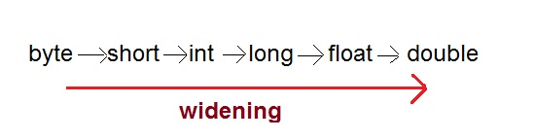
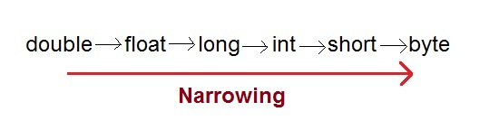
Type Casting
Assigning a value of one type to a variable of another type is known as Type Casting.
In Java, type casting is classified into two types,
Widening/Automatic Type Casting (Implicit)
Narrowing Type Casting(Explicitly done)

Slide 46
Automatic Type Casting
When one type of data is assigned to other type of variable , an automatic type conversion will take place if the following two conditions are satisfied:
The two types are compatible
The destination type is larger than the source type
Such type of casting is called “widening conversion”.
Example:
int can always hold values of byte and short
public static void main(String[] args) {
byte b = 5;
// √ this is correct
int a = b;
}

Slide 47
Casting Incompatible Types
To create a conversion between two incompatible types, you must use a cast
A cast is an explicit type conversion.
Such type is called “narrowing conversion”.
Syntax:
(target-type) value
Example:
public static void main(String[] args) {
int a = 5;
// × this is not correct
byte b = a;
// √ this is correct
byte b = (byte)a ;
}

Slide 48

Operator
Perform definite operation

Slide 49
Operators
Arithmetic Operators
Relational Operators
Bitwise Operators
Logical Operators
Assignment Operators
Conditional / Ternary Operator
Instance of Operator

Slide 50
Operators
An operator is a symbol to perform specific mathematical or logical functions.
We use operators in maths to perform certain operations, e.g. +, -, *, /, etc.
Unary operators (++, --) take one operand, Binary operators (+, -, *, /) take two operands.
Programming languages are rich in operators which can be divided in following categories,
Sr. | Operator | Examples
1 | Arithmetic Operators | +, -, *, /, %
2 | Relational Operators | <, <=, >, >=, ==, !=
3 | Logical Operators | &&, ||, !
4 | Assignment Operators | =, +=, -=, *=, /=
5 | Increment and Decrement Operators | ++, --
6 | Conditional Operator | ?:
7 | Bitwise Operators | &, |, ^, <<, >>

Slide 51
Arithmetic Operators
An arithmetic operator performs basic mathematical calculations such as addition, subtraction, multiplication, division etc on numerical values (constants and variables).
Operator | Meaning | Example | Description
+ | Addition | a + b | Addition of a and b
- | Subtraction | a – b | Subtraction of b from a
* | Multiplication | a * b | Multiplication of a and b
/ | Division | a / b | Division of a by b
% | Modulo division- remainder | a % b | Modulo of a by b

Slide 52
Relational Operators
A relational operators are used to compare two values.
They check the relationship between two operands, if the relation is true, it returns 1; if the relation is false, it returns value 0.
Relational expressions are used in decision statements such as if, for, while, etc…
Operator | Meaning | Example | Description
< | is less than | a < b | a is less than b
<= | is less than or equal to | a <= b | a is less than or equal to b
> | is greater than | a > b | a is greater than b
>= | is greater than or equal to | a >= b | a is greater than or equal to b
== | is equal to | a == b | a is equal to b
!= | is not equal to | a != b | a is not equal to b

Slide 53
Relational Operators
Note : A = 10 & B = 20
Operator | Description | Example
== | Equals | (A == B) is not true.
!= | Not Equals | (A != B) is true.
> | Greater than | (A > B) is not true.
< | Less than | (A < B) is true.
>= | Greater than equals | (A >= B) is not true.
<= | Less than equals | (A <= B) is true.

Slide 54
Bitwise Operators
Note : A = 60 & B = 13
Operator | Description | Example
& | Binary AND Operator | A & B = 12 which is 0000 1100
| | Binary OR Operator | A | B = 61 which is 0011 1101
^ | Binary XOR Operator | A ^ B = 49 which is 0011 0001
~ | Binary Ones Complement Operator | ~A = -61 which is 1100 0011 in 2's complement form due to a signed binary number.
<< | Binary Left Shift Operator | A << 2 = 240 which is 1111 0000
>> | Binary Right Shift Operator. | A >> 2 = 15 which is 1111
>>> | Shift right zero fill operator. | A >>>2 = 15 which is 0000 1111

Slide 55
Logical Operators
Logical operators are decision making operators.
They are used to combine two expressions and make decisions.
An expression containing logical operator returns either 0 or 1 depending upon whether expression results false or true.
Operator | Meaning | Example (Let’s assume c=5 and d=2)
&& | Logical AND. True only if all operands are true | expression ((c==5) && (d>5)) equals to 0.
| | | Logical OR. True only if either one operand is true | expression ((c==5) || (d>5)) equals to 1.
! | Logical NOT. True only if the operand is false | expression !(c==5) equals to 0.
a | b | a && b | a || b
0 | 0 | 0 | 0
0 | 1 | 0 | 1
1 | 0 | 0 | 1
1 | 1 | 1 | 1

Slide 56
Logical Operators
Note : A = true & B = false
Operator | Description | Example
&& | Logical AND operator | (A && B) is false.
|| | Called Logical OR Operator | (A || B) is true.
! | Called Logical NOT Operator | !(A && B) is true.

Slide 57
Assignment Operators
Assignment operators are used to assign a new value to the variable.
The left side operand of the assignment operator is a variable and right side operand of the assignment operator is a value or a result of an expression.
Meaning of = in Maths and Programming is different.
Value of LHS & RHS is always same in Math.
In programming, value of RHS is assigned to the LHS
Operator | Meaning
= | Assigns value of right side to left side. Suppose a=5 and b=10. a=b means now value of a is 10.
+= | a += 1 is same as a = a + 1 | Shorthand Assignment Operators
-= | a -= 5 is same as a = a – 5
*= | a *= b is same as a = a * b
/= | a /= c is same as a = a / c
%= | a %= 10 is same as a = a % 10

Slide 58
Assignment Operators
Operator | Description | Example
= | Simple assignment operator | C = A + B will assign value of A + B into C
+= | Add AND assignment operator | C += A is equivalent to C = C + A
-= | Subtract AND assignment operator | C -= A is equivalent to C = C - A
*= | Multiply AND assignment operator | C *= A is equivalent to C = C * A
/= | Divide AND assignment operator | C /= A is equivalent to C = C / A
%= | Modulus AND assignment operator | C %= A is equivalent to C = C % A
<<= | Left shift AND assignment operator | C <<= 2 is same as C = C << 2
>>= | Right shift AND assignment operator | C >>= 2 is same as C = C >> 2
&= | Bitwise AND assignment operator | C &= 2 is same as C = C & 2
^= | bitwise exclusive OR and assignment operator | C ^= 2 is same as C = C ^ 2
|= | bitwise inclusive OR and assignment operator | C |= 2 is same as C = C | 2

Slide 59
Increment / Decrement Operators
Increment and decrement operators are unary operators that add or subtract one, to or from their operand.
the increment operator ++ increases the value of a variable by 1, e.g. a++ means a=a+1
the decrement operator -- decreases the value of a variable by 1. e.g. a–– means a=a–1
If ++ operator is used as a prefix (++a) then the value of a is incremented by 1 first then it returns the value.
If ++ operator is used as a postfix (a++) then the value of a is returned first then it increments value of a by 1.
Expression | Evaluation (Let’s say a=10, c=15)
b = a++ | Value of b would be 10 and value of a would be 11.
b = ++a | Value of b & a would be 11.
b = a-- | Value of b would be 10 and value of a would be 9.
b = --a | Value of b & a would be 9.
Expression
b = --a + c++
b = a++ + ++c
b = ++a - ++c
Evaluation (Let’s say a=10, c=15)
b = 24
b = 26
b = –5

Slide 60
Conditional Operator (Ternary)
Conditional Operator ( ? : )
Syntax:
variable x = (expression) ? value if true : value if false
Example:
b = (a == 1) ? 20 : 30;

Slide 61
Operators Precedence & Associativity
Priority matters!

Slide 62
Operator Precedence & Associativity
How does java evaluate 1 + 10 * 9 ?
(1 + 10 ) * 9 = 99 OR 1 + (10 * 9) = 91
To get the correct answer for the given problem Java came up with Operator precedence.
Multiplication have higher precedence than addition so correct answer will be 91 in this case.
For Operator, associativity means that when the same operator appears in a row, then to which direction the expression will be evaluated.
How does java evaluate 1 * 2 + 3 * 4 / 5 ???
2 + 12 / 5
2 + 2.4
4.4

Slide 63
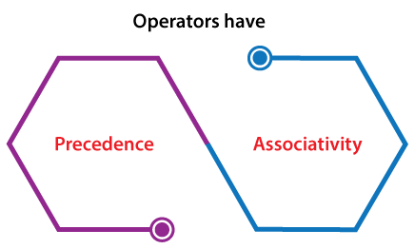
Operators Precedence & Associativity
Operators Precedence and Associativity are two characteristics of operators that determine the evaluation order of sub-expressions in absence of brackets.
Operator precedence determines which operation is performed first in an expression with more than one operators with different precedence.
a=10 + 20 * 30 is calculated as 10 + (20 * 30) and not as (10 + 20) * 30 so answer is 610.
Operators Associativity is used when two operators of same precedence appear in an expression. Associativity can be either Left to Right (L to R) or Right to Left (R to L).
a=100 / 10 * 10
If Left to Right means (100 / 10) * 10 then answer is 100
If Right to Left means 100 / (10 * 10) then answer is 1
Division (/) & Multiplication (*) are Left to Right associative so the answer is 100.

Slide 64
Precedence of Java Operators
Category | Operator | Associativity
Postfix | () [] . (dot operator) | Left to right
Unary | ++ - - ! ~ | Right to left
Multiplicative | * / % | Left to right
Additive | + - | Left to right
Shift | >> >>> << | Left to right
Relational | > >= < <= | Left to right
Equality | == != | Left to right
Bitwise AND | & | Left to right
Bitwise XOR | ^ | Left to right
Bitwise OR | | | Left to right
Logical AND | && | Left to right
Logical OR | || | Left to right
Conditional | ?: | Right to left
Assignment | = += -= *= /= %= >>= <<= &= ^= |= | Right to left
Comma | , | Left to right

Slide 65
Operators Precedence and Associativity
1) Associativity is only used when there are two or more operators of same precedence.
2) All operators with the same precedence have same associativity
Priority | Operator | Description | Associativity
1 | ( ) [ ] . a++ a— | Parentheses (function call) Brackets (array subscript) Member selection via object name Postfix increment/decrement | left-to-right
2 | ++a —a + – ! ~ (type) * & sizeof | Prefix increment/decrement Unary plus/minus Logical negation/bitwise complement Cast (convert value to temporary value of type) De-reference Address (of operand) Determine size in bytes on this implementation | right-to-left
3 | * / % | Multiplication/division/modulus | left-to-right
4 | + – | Addition/subtraction | left-to-right
5 | << >> | Bitwise shift left, Bitwise shift right | left-to-right
6 | < <= > >= | Relational less than/less than or equal to Relational greater than/greater than or equal to | left-to-right
Priority | Operator | Description | Associativity
7 | == != | is equal to/is not equal to | left-to-right
8 | & | Bitwise AND | left-to-right
9 | ^ | Bitwise exclusive OR | left-to-right
10 | | | Bitwise OR | left-to-right
11 | && | Logical AND | left-to-right
12 | | | | Logical OR | left-to-right
13 | ? : | Ternary conditional | right-to-left
14 | = += -= *= /= %= &= ^= |= <<= >>= | Assignment Shorthand Assignments Bitwise exclusive/inclusive assignment Bitwise shift left/right assignment | right-to-left
15 | , | Comma (separate expressions) | left-to-right

Slide 66
Exercise
Sr. | Exercise
1. | int i=1; i=2+2*i++;
2. | int a=2,b=7,c=10; c=a==b;
3. | int a=2,b=7,c=10; c=a!=b;
4. | int a=100 + 200 / 10 - 3 * 10
5. | int a = 2, b = 6, c = 12, d; d = a * b + c / b; System.out.println("The value of d ="+d);
Answer
4
0
1
90
14

Slide 67
Interview Questions
What is the default value of local variables in Java?
Can you compare a boolean with an int variable in Java?
Difference between double and float variables in Java.
Determine Output
class Main {
public static void main(String args[]) {
int t;
System.out.println(t);
}
}

Slide 68
Assignment
1. | int i = 11; i = i++ + ++i;
2. | int a=11, b=22, c; c = a + b + a++ + b++ + ++a + ++b;
3. | int i=0; i = i++ - --i + ++i - i--;
24
a=13
b=24
c=103
i=0

Slide 69
Unit-1(Part-III) Array and Control Statements
Object-Oriented Programming
2305CS102
Prof. Swati R Sharma
Computer Engineering Department
swati.sharma@darshan.ac.in

Slide 70
Unit-1

Looping
What we will learn
if, else, nested if, if-else ladder
switch
Looping Statement: while, do-while, for, foreach,
break and continue statement
Single and Multidimensional Array

Slide 71
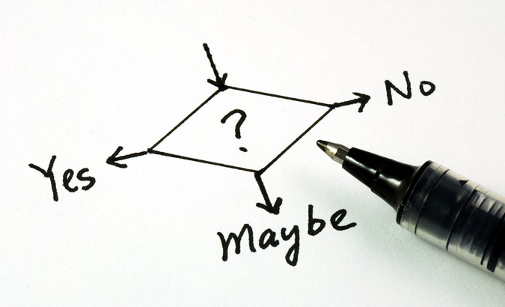

Slide 72
Decision Making
Compiler executes program statements sequentially.
Decision making statements are used to control the flow of program execution.
It allows us to control whether a set of program statement should be executed or not.
It evaluates condition or logical expression first and based on its result (true or false), the control is transferred to the particular statement.
If result is true then it takes one path else it takes another path.
True
condition
False
…
…
…

Slide 73
Decision Making Statements
Commonly used decision making statements are
One way Decision: if (Also known as simple if)
Two way Decision: if…else
Multi way Decision: if…else if…else if…else
Decision within Decision: nested if
Two way Decision: ?: (Conditional Operator)
n-way Decision: switch…case

Slide 74
if
One way Decision

Slide 75
if
if statement is the most simple decision-making statement also known as simple if.
An if statement consists of a boolean expression followed by one or more statements.
If the expression is true, then 'statement-inside' will be executed, otherwise 'statement-inside' is skipped and only 'statement-outside' will be executed.
It is used to decide whether a block of statements will be executed or not i.e if a certain condition is true then a block of statement is executed otherwise not.
condition
False
if(condition)
{
// Statements to execute if condition is true
}
True
statement-inside

Slide 76
WAP to print if a number is positive
import java.util.*;
class MyProgram{
public static void main (String[] args){
int x;
Scanner sc = new Scanner(System.in);
x = sc.nextInt();
if(x > 0){
System.out.println("number is a positive");
}
}

Slide 77
Exercise
Write a program which reads two numbers and based on different between it prints either of following message DIFFERENCE IS POSITIVE or DIFFERENCE IS NEGATIVE.

Slide 78
WAP to print if a number is odd or even
import java.util.*;
class MyProgram{
public static void main (String[] args){
int x;
Scanner sc = new Scanner(System.in);
x = sc.nextInt();
if( x % 2 == 1 ){
System.out.println("number is a odd");
}
if( x % 2 == 0 ){
System.out.println("number is a even");
}
}

Slide 79
if…else
Two way Decision

Slide 80
If…else
For a simple if, if a condition is true, the compiler executes a block of statements, if condition is false then it doesn’t do anything.
What if we want to do something when the condition is false? if…else is used for the same.
If the 'expression' is true then the 'statement-block-1' will get executed else 'statement-block-2' will be executed.
if(condition)
{
// statement-block-1
// to execute if condition is true
}
else
{
// statement-block-2
// to execute if condition is false
}
True
condition
False
statement-block-1
statement-block-2
…

Slide 81
WAP to print if a number is positive or negative
import java.util.*;
class MyProgram{
public static void main (String[] args){
int x;
Scanner sc = new Scanner(System.in);
x = sc.nextInt();
if (x > 0){
System.out.println("Number is positive");
}//if
else{
System.out.println("Number is negative");
}//else
}//main
}//class

Slide 82
WAP to print if a number is odd or even
import java.util.*;
class MyProgram{
public static void main (String[] args){
int x;
Scanner sc = new Scanner(System.in);
x = sc.nextInt();
if( x % 2 == 1 ){
System.out.println("number is a odd");
}
else{
System.out.println("number is a even");
}
}

Slide 83
Exercise
Any year is entered through the keyboard, write a program to determine whether the year is leap or not.
Write a program to check whether a triangle is valid or not, when the three angles of the triangle are entered through the keyboard. A triangle is valid if the sum of all the three angles is equal to 180 degrees.

Slide 84
if…else if…else
Multi way Decision

Slide 85
if…else if…else
if…else if…else statement is also known as if-else-if ladder which is used for multi way decision making.
It is used when there are more than two different conditions.
It tests conditions in a sequence, from top to bottom.
If first condition is true then the associated block with if statement is executed and rest of the conditions are skipped.
If condition is false then then the next if condition will be tested, if it is true then the associated block is executed and rest of the conditions are skipped. Thus it checks till last condition.
Condition is tested only and only when all previous conditions are false.
The last else is the default block which will be executed if none of the conditions are true.
The last else is not mandatory. If there are no default statements then it can be skipped.
if(condition 1)
{
statement-block1;
}
else if(condition 2)
{
statement-block2;
}
else if(condition 3)
{
statement-block3;
}
else if(condition 4)
{
statement-block4;
}
else
default-statement;

Slide 86
if-else-if ladder
condition1
False
if(condition 1)
{
statement-block1;
}
else if(condition 2)
{
statement-block2;
}
else if(condition 3)
{
statement-block3;
}
else if(condition 4)
{
statement-block4;
}
else
default-statement;
True
condition2
False
…
False
True
condition3
…
True
…
…

Slide 87
WAP to print if a number is zero or positive or negative
import java.util.*;
class MyProgram{
public static void main (String[] args){
int x;
Scanner sc = new Scanner(System.in);
x = sc.nextInt();
if(x > 0){
System.out.println(" number is a positive");
}
else if(x < 0) {
System.out.println(" number is a negative");
}
else{
System.out.println(" number is a zero");
}
}

Slide 88
WAP to print day name from day number
public class Demo {
public static void main(String[] args) {
int d;
Scanner sc = new Scanner(System.in);
d = sc.nextInt();
if (d == 1 ) System.out.println(“Monday”);
else if (d == 2) System.out.println(“Tuesday“);
else if (d == 3) System.out.println(“Wednesday“);
else if (d == 4) System.out.println(“Thursday“);
else if (d == 5) System.out.println(“Friday“);
else if (d == 6) System.out.println(“Saturday“);
else System.out.println(“Sunday“);
}
}

Slide 89
if-else statement: WAP to display Exam Result
int marks = 65;
if (marks < 60) {
System.out.println("fail");
} else if (marks >= 60 && marks < 80) {
System.out.println("B grade");
} else if (marks >= 80 && marks < 90) {
System.out.println("A grade");
} else if (marks >= 90 && marks < 100) {
System.out.println("A+ grade");
} else {
System.out.println("Invalid!");
}

Slide 90
Nested If
A nested if is an if statement that is the target of another if statement.
Nested if statements mean an if statement inside another if statement.
The statement connected to the nested if statement is only executed when -:
condition of outer if statement is true, and
condition of the nested if statement is also true.
Note: There could be an optional else statement associated with the outer if statement, which is only executed when the condition of the outer if statement is evaluated to be false and in this case, the condition of nested if condition won't be checked at all.
if(condition 1)
{
if(condition 2)
{
nested-block;
}
else
{
nested-block;
}
}//if
else if(condition 3)
{
statement-block3;
}
else(condition 4)
{
statement-block4;
}

Slide 91
Nested If statement:WAP Login
We can also use if/else if statement inside another if/else if statement, this is known as nested if statement.
int username = Integer.parseInt(args[0]);
int password = Integer.parseInt(args[1]);
double balance = 123456.25;
if(username==1234){
if(password==987654){
System.out.println("Your Balance is ="+balance);
}
else{
System.out.println("Password is invalid");
}
}
else{
System.out.println("Username is invalid");
}

Slide 92
Exercise
In a company an employee is paid as under:
If his basic salary is less than Rs. 1500, then HRA = 10% of basic salary and DA = 90% of basic salary.
If his salary is either equal to or above Rs. 1500, then HRA = Rs. 500 and DA = 98% of basic salary.
Employee's salary is input through the keyboard, write a program to find his gross salary.

Slide 93
switch…case
n-way Decision

Slide 94
Switch…case
switch…case is a multi-way decision making statement.
It is similar to if-else-if ladder statement.
It executes one statement from multiple conditions.
switch (expression)
{
case constant 1:
// Statement-1
break;
case constant 2:
// Statement-2
break;
case constant 3:
// Statement-3
break;
default:
// Statement-default
// if none of the above case matches then this block would be executed.
}

Slide 95
Switch…case: WAP to print day based on number entered
switch (d) {
case 1:
System.out.println(“Monday“); break;
case 2:
System.out.println(“Tuesday“); break;
case 3:
System.out.println(“Wednesday“); break;
case 4:
System.out.println(“Thursday“); break;
case 5:
System.out.println(“Friday“); break;
case 6:
System.out.println(“Saturday“); break;
case 7:
System.out.println(“Sunday“); break;
default:
System.out.println(“Invalid Day“);
} //switch
}
}
public class Demo {
public static void main(String[] args){
int d;
Scanner sc= new Scanner(System.in);
d = sc.nextInt();

Slide 96
Switch…case
switch statement executes one statement from multiple conditions. It is like if-else-if ladder statement.
public class SwitchExampleDemo {
public static void main(String[] args)
{
int number = 20;
switch (number) {
case 10:
System.out.println("10");
break;
case 20:
System.out.println("20");
break;
default:
System.out.println("Not 10 or 20");
}
}
}

Slide 97
Exercise
Write a menu driven program that allows user to enters five numbers and then choose between finding the smallest, largest, sum or average. Use switch case to determine what action to take. Provide error message if an invalid choice is entered.

Slide 98
Points to remember for switch…case
The condition in the switch should result in a constant value otherwise it would be invalid.
In some languages, switch statements can be used for integer values only.
Duplicate case values are not allowed.
The value for a case must be of the same data type as the variable in the switch.
The value for a case must be a constant.
variables are not allowed as an argument in switch statement.
The break statement is used inside the switch to terminate a statement sequence.
The break statement is optional, if eliminated, execution will continue on into the next case.
The default statement is optional and can appear anywhere inside the switch block.

Slide 99
Exercise
Write a Java program to get a number from the user and print whether it is positive or negative.
Write a program to find maximum no from given 3 no.
The marks obtained by a student in 5 different subjects are input through the keyboard.
The student gets a division as per the following rules:
Percentage above or equals to 60-first division
Percentage between 50 to 59-second division
Percentage between 40 and 49-Third division
Percentage less than 40-fail
Write a program to calculate the division obtained by the student.
Write a Java program that takes a number from the user and displays the name of the weekday accordingly (For example if user enter 1 program should return Monday) .

Slide 100

Introduction to loop
Repeatedly execute a block of statements

Slide 101
Loop
Sometimes we need to repeat certain actions several times or till the some criteria is satisfied.
Loop constructs are used to iterate a block of statements several times.
Loop constructs repeatedly execute a block of statements for a fixed number of times or till some condition is satisfied
Flowchart of if (true-block executed only once)
Flowchart of while
(true-block executed till condition is true)
condition
False
condition
False
True
True
true-block
true-block

Slide 102
Looping Statements
Following are looping statements in any programming language,
Entry Controlled while, for
Exit Controlled do…while
Unconditional Jump goto (It is advised to never use goto in a program)

Slide 103
while
Entry Controlled Loop

Slide 104
while
while is a entry controlled loop.
It executes a block of statements till the condition is true.
while(condition)
{
// true-block
}
Flowchart of while
(true-block executed till condition is true)
condition
False
int i = 1;
while (i <= 5)
{
System.out.println(i);
i++;
}
True
true-block

Slide 105
While Loop
while loop is used to iterate a part of the program several times. while is entry control loop.
If the number of iteration is not fixed, it is recommended to use while loop.
//code will print 1 to 9
public class WhileLoopDemo {
public static void main(String[] args) {
int number = 1;
while(number < 10) {
System.out.println(number);
number++;
}
}
}

Slide 106
Do-while Loop
do-while loop is executed at least once because condition is checked after loop body.
//code will print 1 to 9
public class DoWhileLoopDemo {
public static void main(String[] args) {
int number = 1;
do {
System.out.println(number);
number++;
}while(number < 10) ;
}
}

Slide 107
WAP to print odd numbers between 1 to n
import java.util.*;
class WhileDemo{
public static void main (String[] args){
int n,i=1;
Scanner sc = new Scanner(System.in);
System.out.print("Enter a number:");
n = sc.nextInt();
while(i <= n){
if(i%2!=0)
System.out.println(i);
i++;
}
}}
Output
Enter a number:10 1 3 5 7 9

Slide 108
WAP to print factors of a given number
import java.util.*;
class WhileDemo{
public static void main (String[] args){
int i=1,n;
Scanner sc = new Scanner(System.in);
System.out.print("Enter a Number:");
n = sc.nextInt();
System.out.print(" Factors:");
while(i <= n){
if(n%i == 0)
System.out.print(i +",");
i++;
}
}}
Output
Enter a Number:25 Factors:1,5,25

Slide 109
Exercise: while
WAP to print multiplication table using while loop
Write a program that calculates and prints the sum of the even integers from 1 to 10.

Slide 110
for(;;)
Entry Controlled Loop

Slide 111
for
for is an entry controlled loop
Statements inside the body of for are repeatedly executed till the condition is true
The initialization statement is executed only once, at the beginning of the loop.
Then, the condition is evaluated.
If the condition is true, statements inside the body of for loop are executed
If the condition is false, the for loop is terminated.
Then, increment / decrement statement is executed
Again the condition is evaluated and so on so forth till the condition is true.
for (initialization; condition; increment /decrement)
{
// statements
}
int i = 1;
while (i <= 5) {
System.out.print("Hell o World!");
i++;
}
for(i=1; i <= 5; i++)
{
System.out.print("Hello World!");
}

Slide 112
For Loop
for loop is used to iterate a part of the program several times.
If the number of iteration is fixed, it is recommended to use for loop.
//code will print 1 to 9
public class ForLoopDemo {
public static void main(String[] args)
{
for(int number=1;number<10;number++)
{
System.out.println(number);
}
}
}

Slide 113
WAP to print odd numbers between 1 to n
import java.util.*;
class MyProgram{
public static void main (String[] args){
int i=1;
Scanner sc = new Scanner(System.in);
n = sc.nextInt();
for(i=1; i<=n; i++) {
if(i%2==1)
System.out.println(i);
}//for
}//
}

Slide 114
WAP to print factors of a given number
import java.util.*;
class MyProgram{
public static void main (String[] args){
int i=1;
Scanner sc = new Scanner(System.in);
n = sc.nextInt();
for(i=1; i<=n; i++){
if(n%i == 0)
System.out.println(i);
}
}
}

Slide 115
Exercise: for
Write a program to print average of n numbers.
Write a program that calculates and prints the sum of the even integers from 1 to 10.

Slide 116
do…while
Exit Controlled Loop

Slide 117
do…while
do…while is an exit controlled loop.
Statements inside the body of do…while are repeatedly executed till the condition is true.
while loop executes zero or more times, do…while loop executes one or more times.
do
{
// true-block
}
while(condition) ;
Flowchart of while
Flowchart of do…while
condition
False
true-block
True
condition
true-block
True
False

Slide 118
WAP to print 1 to 10 using do-while loop
import java.util.*;
class MyProgram{
public static void main (String[] args){
int i=1;
do{
System.out.println(i);
i++;
}while(i <= 10);
}
}

Slide 119
continue
Skip the statement in the iteration

Slide 120
continue
Sometimes, it is required to skip the remaining statements in the loop and continue with the next iteration.
continue statement is used to skip remaining statements in the loop.
continue is keyword.

Slide 121
WAP to calculate the sum of positive numbers.
import java.util.*;
class ContinueDemo{
public static void main(String[] args) {
int a,n,sum=0;
Scanner sc = new Scanner(System.in);
n = sc.nextInt();
for(int i=0;i<n;i++){
a = sc.nextInt();
if(a<0){
continue;
System.out.println("a="+a);//error:unreachable statement
}//if
sum=sum+a;
}//for
System.out.println("sum="+sum);
}
}

Slide 122
break
Early exit from the loop

Slide 123
break
Sometimes, it is required to early exit the loop as soon as some situation occurs.
E.g. searching a particular number in a set of 100 numbers. As soon as the number is found it is desirable to terminate the loop.
break statement is used to jump out of a loop.
break statement provides an early exit from for, while, do…while and switch constructs.
break causes exit from the innermost loop or switch.
break is keyword.

Slide 124
WAP to calculate the sum of given numbers. User will enter -1 to terminate.
import java.util.*;
class BreakDemo{
public static void main (String[] args){
int a,sum=0;
System.out.println("enter numbers_ enter -1 to break");
Scanner sc = new Scanner(System.in);
while(true){
a = sc.nextInt();
if(a==-1)
break;
sum=sum+a;
}//while
System.out.println("sum="+sum);
}
}

Slide 125
Types of loops
Entry Control Loop
Entry Control Loop
Exit Control Loop
Virtual Loop
int i=1;
while(i<=10)
{
i++;
}
int i;
for(i=1;i<=10;i++)
{
i++;
}
int i=1;
do
{
i++;
}
while(i<=10);
int i=1;
p: i++;
if(i<=10)
goto p;
condition
False
Label
Statement
Loop Body
True
True
condition
True
condition
Loop Body
False
goto
label
False

Slide 126
nested loop
loop within a loop

Slide 127
WAP to print given pattern (nested loop)
*
**
***
****
*****
class PatternDemo{
public static void main(String[] args) {
int n=5;
for(int i=1;i<=n;i++){
for(int j=1;j<=i;j++){
System.out.print("*");
}//for j
System.out.println();
}//outer for i
}
}

Slide 128
WAP to print given pattern (nested loop)
1
1 2
1 2 3
1 2 3 4
1 2 3 4 5
class PatternDemo{
public static void main(String[] args) {
int n=5;
for(int i=1;i<=n;i++){
for(int j=1;j<=i;j++){
System.out.print(j+"\t");
}//for j
System.out.println();
}//outer for i
}
}

Slide 129
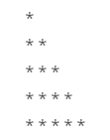
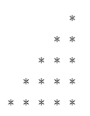

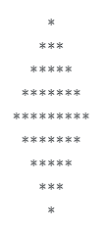
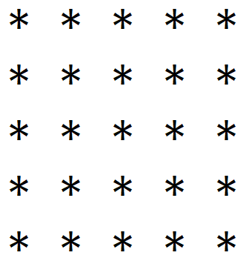
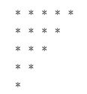

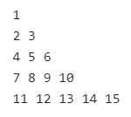


Programs to perform (Looping Statements)
Write a program to print first n odd numbers.
Write a program to check that the given number is prime or not.
Write a program to draw given patterns,

Slide 130
Introduction to Array
Large Data Handling

Slide 131
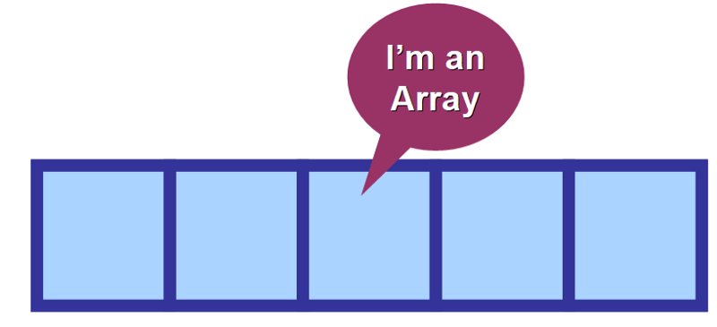
Why Array?
Very often we need to deal with relatively large set of data.
E.g.
Percentage of all the students of the college. (May be in thousands)
Age of all the citizens of the city. (May be lakhs)
We need to declare thousands or lakhs of the variable to store the data which is practically not possible.
We need a solution to store more data in a single variable.
Array is the most appropriate way to handle such data.
As per English Dictionary, “Array means collection or group or arrangement in a specific order.”

Slide 132
Array
An array is a fixed size sequential collection of elements of same data type grouped under single variable name.
[0] | [1] | [2] | [3] | [4] | [5] | [6] | [7] | [8] | [9]
int percentage[10];
Fixed Size
The size of an array is fixed at the time of declaration which cannot be changed later on. Here array size is 10.
Sequential
All the elements of an array are stored in a consecutive blocks in a memory. 10 (0 to 9)
Same Data type
Data type of all the elements of an array is same which is defined at the time of declaration. Here data type is int
Single Variable Name
All the elements of an array will be referred through common name. Here array name is percentage

Slide 133
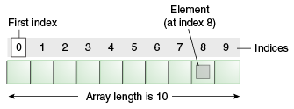
Array declaration
Normal Variable Declaration: int a;
Array Variable Declaration: int b[10];
Individual value or data stored in an array is known as an element of an array.
Positioning / indexing of an elements in an array always starts with 0 not 1.
If 10 elements in an array then index is 0 to 9
If 100 elements in an array then index is 0 to 99
If 35 elements in an array then index is 0 to 34
Variable a stores 1 integer number where as variable b stores 10 integer numbers which can be accessed as b[0], b[1], b[2], b[3], b[4], b[5], b[6], b[7], b[8] and b[9]

Slide 134
Array
Important point about Java array.
An array is derived datatype.
An array is dynamically allocated.
The individual elements of an array is refereed by their index/subscript value.
The subscript for an array always begins with 0.
35
13
28
106
a
35
42
5
83
97
14
a[0]
a[1]
a[2]
a[3]
a[4]
a[5]
a[6]
a[7]
a[8]
a[9]

Slide 135
One-Dimensional Array
An array using one subscript to represent the list of elements is called one dimensional array.
A One-dimensional array is essentially a list of like-typed variables.
Array declaration: type var-name[];
Example: int student_marks[];
Above example will represent array with no value (null).
To link student_marks with actual array of integers, we must allocate one using new keyword.
Example: int student_marks[] = new int[20];

Slide 136
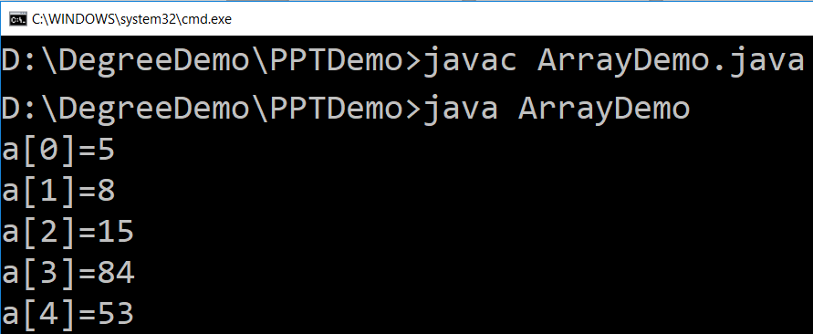
Example (Array)
public class ArrayDemo{
public static void main(String[] args) {
int a[]; // or int[] a
// till now it is null as it does not assigned any memory
a = new int[5]; // here we actually create an array
a[0] = 5;
a[1] = 8;
a[2] = 15;
a[3] = 84;
a[4] = 53;
/* in java we use length property to determine the length
* of an array, unlike c where we used sizeof function */
for (int i = 0; i < a.length; i++) {
System.out.println("a["+i+"]="+a[i]);
}
}
}

Slide 137
WAP to store 5 numbers in an array and print them
import java.util.*;
class ArrayDemo1{
public static void main (String[] args){
int i, n;
int[] a=new int[5];
Scanner sc = new Scanner(System.in);
System.out.print("enter Array Length:");
n = sc.nextInt();
for(i=0; i<n; i++) {
System.out.print("enter a["+i+"]:");
a[i] = sc.nextInt();
}
for(i=0; i<n; i++)
System.out.println(a[i]);
}
}
Output:
enter Array Length:5
enter a[0]:1
enter a[1]:2
enter a[2]:4
enter a[3]:5
enter a[4]:6
1
2
4
5
6

Slide 138
For-each loop
class Array1{
public static void main(String[] args) {
int a[ ]={10,20,30,40,50};
for(int i : a){// for each
System.out.println(i);
}
}
}
Limitations of for-each loop
For-each loops are not appropriate when you want to modify the array.
For-each loops do not keep track of index. So we can not obtain array index using For-Each loop.
For-each only iterates forward over the array in single steps.
For-each cannot process two decision making statements at once.
For-each also has some performance overhead over simple iteration.

Slide 139
WAP to print elements of an array in reverse order
import java.util.*;
public class RevArray{
public static void main(String[] args) {
int i, n;
int[] a;
Scanner sc=new Scanner(System.in);
System.out.print("Enter Size of an Array:");
n=sc.nextInt();
a=new int[n];
for(i=0; i<n; i++){
System.out.print("enter a["+i+"]:");
a[i]=sc.nextInt();
}
System.out.println("Reverse Array");
for(i=n-1; i>=0; i--)
System.out.println(a[i]);
}
}
Output:
Enter Size of an Array:5
enter a[0]:1
enter a[1]:2
enter a[2]:3
enter a[3]:4
enter a[4]:5
Reverse Array
5
4
3
2
1

Slide 140
WAP to count positive number, negative number and zero from an array of n size
import java.util.*;
class ArrayDemo1{
public static void main (String[] args){
int n,pos=0,neg=0,z=0;
int[] a=new int[5];
Scanner sc = new Scanner(System.in);
System.out.print("enter Array Length:");
n = sc.nextInt();
for(int i=0; i<n; i++) {
System.out.print("enter a["+i+"]:");
a[i] = sc.nextInt();
if(a[i]>0)
pos++;
else if(a[i]<0)
neg++;
else
z++;
}
System.out.println("Positive no="+pos);
System.out.println("Negative no="+neg);
System.out.println("Zero no="+z);
}}
Output:
enter Array Length:5
enter a[0]:-3
enter a[1]:5
enter a[2]:0
enter a[3]:-2
enter a[4]:00
Positive no=1
Negative no=2
Zero no=2

Slide 141
Exercise: Array
WAP to count odd and even elements of an array.
WAP to calculate sum and average of n numbers from an array.
WAP to find largest and smallest from an array.

Slide 142

Multidimensional Array

Slide 143
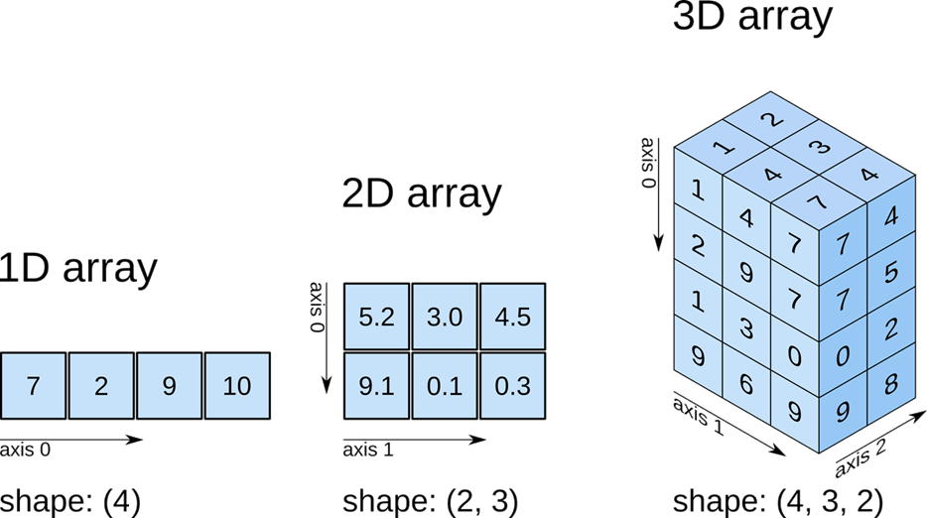
Multidimensional Array

Slide 144
WAP to read 3 x 3 elements in 2d array
import java.util.*;
class Array2Demo{
public static void main(String[] args) {
int size;
Scanner sc=new Scanner(System.in);
System.out.print("Enter size of an array");
size=sc.nextInt();
int a[][]=new int[size][size];
for(int i=0;i<a.length;i++){
for(int j=0;j<a.length;j++){
a[i][j]=sc.nextInt();
}
}
for(int i=0;i<a.length;i++){
for(int j=0;j<a.length;j++){
System.out.print("a["+i+"]["+j+"]:"+a[i][j]+"\t");
}
System.out.println();
}
}
}
 | Column-0 | Column-1 | Column-2
Row-0 | 11 | 18 | -7
Row-1 | 25 | 100 | 0
Row-2 | -4 | 50 | 88
Output:
11
12
13
14
15
16
17
18
19
a[0][0]:11 a[0][1]:12 a[0][2]:13
a[1][0]:14 a[1][1]:15 a[1][2]:16
a[2][0]:17 a[2][1]:18 a[2][2]:19

Slide 145
WAP to perform addition of two 3 x 3 matrices
import java.util.*;
class Array2Demo{
public static void main(String[] args) {
int size;
int a[][],b[][],c[][];
Scanner sc=new Scanner(System.in);
System.out.print("Enter size of an array:");
size=sc.nextInt();
a=new int[size][size];
System.out.println("Enter array elements:");
for(int i=0;i<a.length;i++){
for(int j=0;j<a.length;j++){
System.out.print("Enter a["+i+"]["+j+"]:");
a[i][j]=sc.nextInt();
}
}
b=new int[size][size];
for(int i=0;i<b.length;i++){
for(int j=0;j<b.length;j++){
System.out.print("Enter b["+i+"]["+j+"]:");
b[i][j]=sc.nextInt();
}
}
c=new int[size][size];
for(int i=0;i<c.length;i++){
for(int j=0;j<c.length;j++){
System.out.print("c["+i+"]["+j+"]:“ +(a[i][j]+b[i][j])+"\t");
}
System.out.println();
}
}//main()
}//class

Slide 146
WAP to perform addition of two 3 x 3 matrices
Output:
Enter size of an array:3
Enter array elements:
Enter a[0][0]:1
Enter a[0][1]:1
Enter a[0][2]:1
Enter a[1][0]:1
Enter a[1][1]:1
Enter a[1][2]:1
Enter a[2][0]:1
Enter a[2][1]:1
Enter a[2][2]:1
Enter b[0][0]:4
Enter b[0][1]:4
Enter b[0][2]:4
Enter b[1][0]:4
Enter b[1][1]:4
Enter b[1][2]:4
Enter b[2][0]:4
Enter b[2][1]:4
Enter b[2][2]:4
c[0][0]:5 c[0][1]:5 c[0][2]:5
c[1][0]:5 c[1][1]:5 c[1][2]:5
c[2][0]:5 c[2][1]:5 c[2][2]:5

Slide 147
Initialization of an array elements
One dimensional Array
int a[ ] = { 7, 3, -5, 0, 11 }; // a[0]=7, a[1] = 3, a[2] = -5, a[3] = 0, a[4] = 11
int a[ ] = { 7, 3 }; // a[0] = 7, a[1] = 3
int a[ ] = { 0 }; // all elements of an array are initialized to 0
Two dimensional Array
int a[ ][ ] = { { 7, 3, -5, 10 }, { 11, 13, -15, 2} }; // 1st row is 7, 3, -5, 10 & 2nd row is 11, 13, -15, 2

Slide 148
Multi-Dimensional Array
In java, multidimensional array is actually array of arrays.
Example: int runPerOver[][] = new int[3][6];
length field:
If we use length field with multidimensional array, it will return length of first dimension.
Here, if runPerOver.length is accessed it will return 3
Also if runPerOver[0].length is accessed it will be 6
First Over (a[0])
4
0
1
3
6
1
a[0][0]
a[0][1]
a[0][2]
a[0][3]
a[0][4]
a[0][5]
1
1
0
6
0
4
Second Over (a[1])
a[1][0]
a[1][1]
a[1][2]
a[1][3]
a[1][4]
a[1][5]
2
1
1
0
1
1
Third Over (a[2])
a[2][0]
a[2][1]
a[2][2]
a[2][3]
a[2][4]
a[2][5]

Slide 149
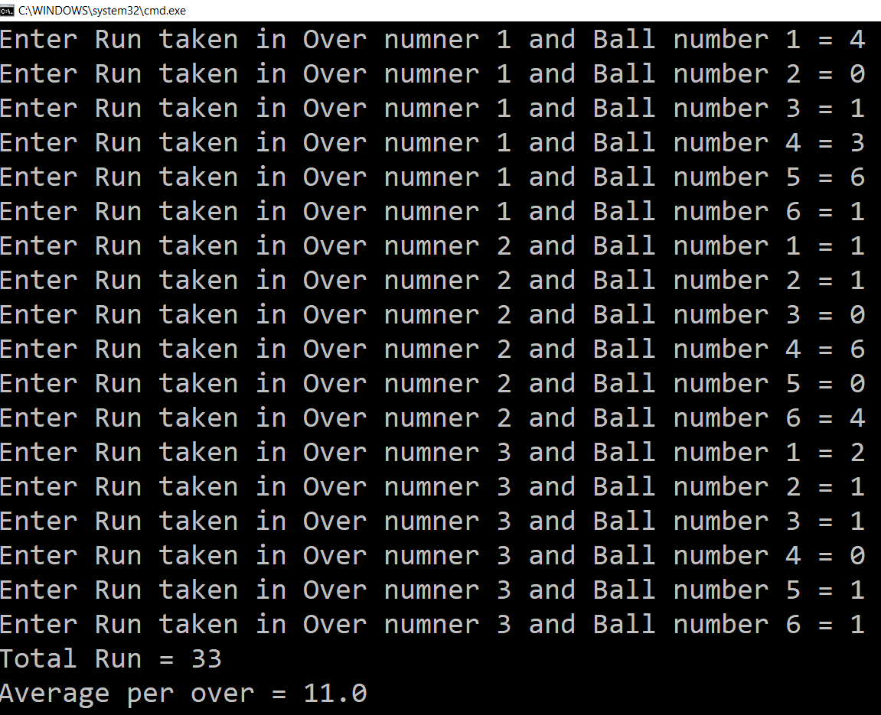
Multi-Dimensional Array (Example)
Scanner s = new Scanner(System.in);
int runPerOver[][] = new int[3][6];
for (int i = 0; i < 3; i++) {
for (int j = 0; j < 6; j++) {
System.out.print("Enter Run taken" +
" in Over numner " + (i + 1) +
" and Ball number " + (j + 1) + " = ");
runPerOver[i][j] = s.nextInt();
}
}
int totalRun = 0;
for (int i = 0; i < 3; i++) {
for (int j = 0; j < 6; j++) {
totalRun += runPerOver[i][j];
}
}
double average = totalRun / (double) runPerOver.length;
System.out.println("Total Run = " + totalRun);
System.out.println("Average per over = " + average);

Slide 150
Multi-Dimensional Array (Cont.)
manually allocate different size:
int runPerOver[][] = new int[3][];
runPerOver[0] = new int[6];
runPerOver[1] = new int[7];
runPerOver[2] = new int[6];
initialization:
int runPerOver[][] = {
{0,4,2,1,0,6},
{1,-1,4,1,2,4,0},
{6,4,1,0,2,2},
}
Note : here to specify extra runs (Wide, No Ball etc.. ) negative values are used

Slide 151
Searching in Array
Searching is the process of looking for a specific element in an array. for example, discovering whether a certain element is included in the array.
Searching is a common task in computer programming. Many algorithms and data structures are devoted to searching.
We will discuss two commonly used approaches,
Linear Search: The linear search approach compares the key element key sequentially with each element in the array. It continues to do so until the key matches an element in the array or the array is exhausted without a match being found.
Binary Search: The binary search first compares the key with the element in the middle of the array. Consider the following three cases:
If the key is less than the middle element, you need to continue to search for the key only in the first half of the array.
If the key is equal to the middle element, the search ends with a match.
If the key is greater than the middle element, you need to continue to search for the key only in the second half of the array.
Note: Array should be sorted in ascending order if we want to use Binary Search.

Slide 152
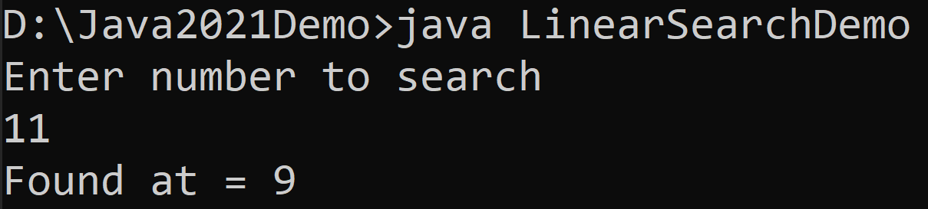
Linear Search
import java.util.Scanner;
public class LinearSearchDemo{
public static void main(String[] args){
int[] myArray = {5,3,6,8,4,6,2,8,9,11};
Scanner sc = new Scanner(System.in);
System.out.println("Enter number to search");
int searchNumber = sc.nextInt();
sc.close();
boolean flag = false;
for(int i=0;i<myArray.length;i++){
if(myArray[i]==searchNumber){
System.out.println("Found at = "+i);
flag = true;
break;
}
}
if(!flag){
System.out.println("Number does not exist in array");
}
}
}

Slide 153
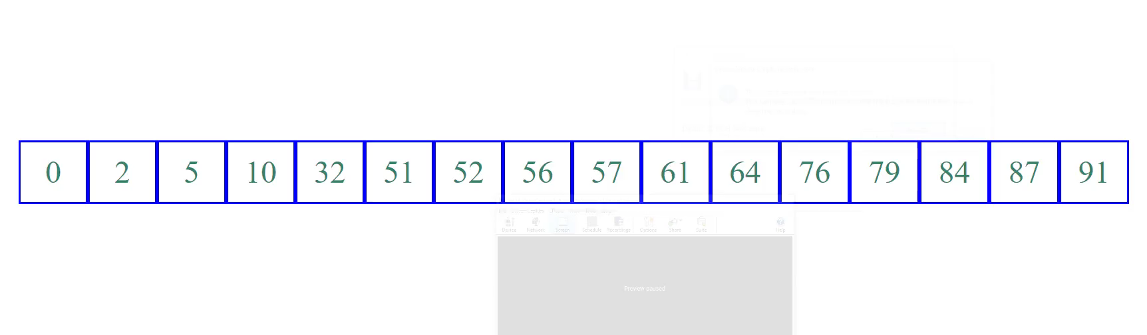
Binary Search (Animation)

Slide 154
Binary Search
import java.util.Scanner;
public class BinarySearchDemo {
public static void main(String[] args) {
int[] myArray
= {2,3,5,6,8,9,11,18,29,65};
Scanner sc = new Scanner(System.in);
System.out.println
("Enter number to search");
int searchNumber = sc.nextInt();
sc.close();
int low = 0;
int high = myArray.length - 1;
boolean isFound = false;
while(high>=low) {
int mid = (high + low) / 2 ;
if(searchNumber < myArray[mid]) {
high = mid - 1;
}
else if(searchNumber == myArray[mid]) {
System.out.println("Found at = "+mid);
isFound = true;
break;
}
else {
low = mid + 1;
}
}
if(!isFound) {
System.out.println
("Number does not exist in array");
}
}
}

Slide 155
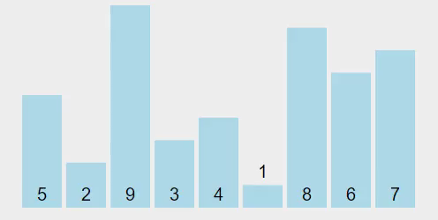
Sorting Array
Sorting, like searching, is a common task in computer programming. Many different algorithms have been developed for sorting.
There are many sorting techniques available, we are going to explore selection sort.
Selection sort
finds the smallest number in the list and swaps it with the first element.
It then finds the smallest number remaining and swaps it with the second element, and so on, until only a single number remains.

Slide 156
Selection Sort (Example)
int a[] = { 5, 2, 9, 3, 4, 1, 8, 6, 7 };
for (int i = 0; i < a.length - 1; i++) {
// Find the minimum in the list[i..a.length-1]
int currentMin = a[i];
int currentMinIndex = i;
for (int j = i + 1; j < a.length; j++) {
if (currentMin > a[j]) {
currentMin = a[j];
currentMinIndex = j;
}
}
// Swap a[i] with a[currentMinIndex] if necessary
if (currentMinIndex != i) {
a[currentMinIndex] = a[i];
a[i] = currentMin;
}
}
for(int temp: a) { // this is foreach loop
System.out.print(temp + ", ");
}

Slide 157
Thank You

